Slide 1




DEPARTMENT OF COMPUTER SCIENCE AND INFORMATION TECHNOLOGY
TITLE OF THE PROJECT :
Design and Educational Implementation of a Web-Based Hybrid Encryption System Using Django
Presented by :
K Kalyani [22KD1A0729]
R Manasa [22KD1A0751]
T Shyam kumar [22KD1A0759]
K Sai Prakash [22KD1A0728]
Under Esteemed Guidance of:
Mr. S.V.R Vara Prasad
Assistant Professor
CSIT-LIET
Notes:
‹#›

Slide 2
Abstract :
The increasing reliance on web applications for handling sensitive user data has made application-level security a critical requirement. Although cryptographic algorithms are well established, their practical integration into web frameworks is often limited to theoretical demonstrations or isolated scripts.
This paper presents the design and implementation of a web-based encryption system developed using the Django framework to demonstrate the practical application of cryptographic techniques in a real-time web environment.
The system allows authenticated users to perform secure text encryption and decryption using symmetric algorithms such as Advanced Encryption Standard (AES) and Triple Data Encryption Standard (3DES), while RSA is employed for secure symmetric key protection. Additionally, SHA256 hashing is used to ensure secure password storage and user authentication.
Experimental observations conducted on varying input sizes indicate that AES provides lower computational overhead compared to 3DES, while hybrid encryption introduces additional processing cost due to asymmetric key operations.
The primary objective of this work is to provide an educational and practical reference for implementing cryptography within web applications. The results confirm that established encryption algorithms can be effectively combined with modern web frameworks to achieve secure and user-accessible data protection.
This work is intended primarily as an educational and practical implementation reference rather than a proposal of new cryptographic algorithms.

Slide 3
Introduction :
With the rapid growth of the internet and cloud computing, a large amount of data is being shared online every day.
This data often contains sensitive information like passwords, personal details, and financial records.So, protecting this data has become very important.
Traditional encryption methods have some limitations. AES is very fast and efficient, but it has a problem in securely sharing the key. On the other hand, RSA provides strong security, but it is slow when handling large data.
To overcome these issues, we use hybrid encryption, which combines AES and RSA. AES is used for fast data encryption, and RSA is used for secure key exchange. This provides both security and performance.
This approach is widely used in real-world applications like HTTPS, banking systems, and cloud storage.
Notes:
‹#›

Slide 4
Problem Statement
Background: With the rapid increase in online data sharing and cloud storage, protecting sensitive information has become a major challenge. Data such as personal details, passwords, and financial records are frequently transmitted over networks, making them vulnerable to cyber attacks and unauthorized access. Traditional encryption techniques have limitations in balancing security and performance.
Challenges:
AES (Symmetric Encryption): Provides high speed and efficiency for encrypting large amounts of data but relies on a single
secret key, making secure key distribution and management difficult.
RSA (Asymmetric Encryption):Provides strong security and solves the key distribution problem but is computationally slow and
inefficient for encrypting large data.
Problem Statement: Existing encryption techniques either provide high speed (AES) or strong security (RSA), but not both. There is a need for a system that ensures secure key exchange while maintaining efficient performance for data encryption and decryption.
Problem Definition: To design and implement a web-based hybrid encryption system using Django that combines the speed of AES encryption with the security of RSA key exchange, ensuring secure data transmission and efficient performance.

Slide 5
Objectives:
Main Aim: To design and analyze a secure encryption system by comparing AES encryption with a hybrid cryptographic approach in order to improve data security while maintaining good performance.
1
2
To study basic cryptographic techniques used for data security
To design an encryption system using AES for performance and hybrid cryptography for security
3
4
To implement AES and hybrid encryption models using Python
To analyze and compare the performance of AES and hybrid encryption using benchmarking results
So, the main aim of our project is to improve data security.
  Firstly, we studied encryption techniques.
  Then we designed and implemented AES and hybrid encryption models(combine the speed of symmetric encryption and the security of asymmetric encryption ).
  Finally, we analyzed and compared their performance to understand which approach gives better security with acceptable speed.
Notes:
‹#›

Slide 6
Literature Survey
S.NO | Authors | Title of The Paper | Technology Used | Advantages | Research Gaps
1 | Daemen, J., & Rijmen, V. | The Design of Rijndael: AES — The Advanced Encryption Standard | AES (Symmetric Encryption) | High speed, efficient for bulk data encryption | Key distribution problem
2 | Tuchman, W. | Hellman Presents No Shortcut Solutions to DES | DES / 3DES | Strong security for its time | Vulnerable to modern attacks, slower performance
3 | Stallings, W. | Cryptography and Network Security: Principles and Practice | General Cryptographic Techniques | Provides strong theoretical foundation | Lacks practical hybrid implementation
4 | Khan, M. | RSA and AES Based Hybrid Encryption Technique for Enhancing Data Security in Cloud Computing | AES + RSA Hybrid | Improved security and key management | Slight performance overhead
5 | Bharti, J., & Singh, S. | A Hybrid Approach Using AES-RSA Encryption for Cloud Data Security | AES + RSA Hybrid | Balanced security and performance | Needs optimization for large-scale systems
Table-1: Literature Review of Existing Approaches

Slide 7

Proposed System:
Our proposed system integrates a hybrid cryptographic encryption model to leverage the best of both worlds: The speed of symmetric encryption and the security of asymmetric key exchange.
                AES → Data encryption
                RSA → Key exchange
                Hybrid = Secure + Fast
AES for Data
Utilizes AES for the high-speed encryption and decryption of bulk data.
Asymmetric Key Exchange
Employs asymmetric encryption for the secure and reliable exchange of the AES session key.
Dual Goal
Aims to achieve both robust security and efficient performance.

Slide 8
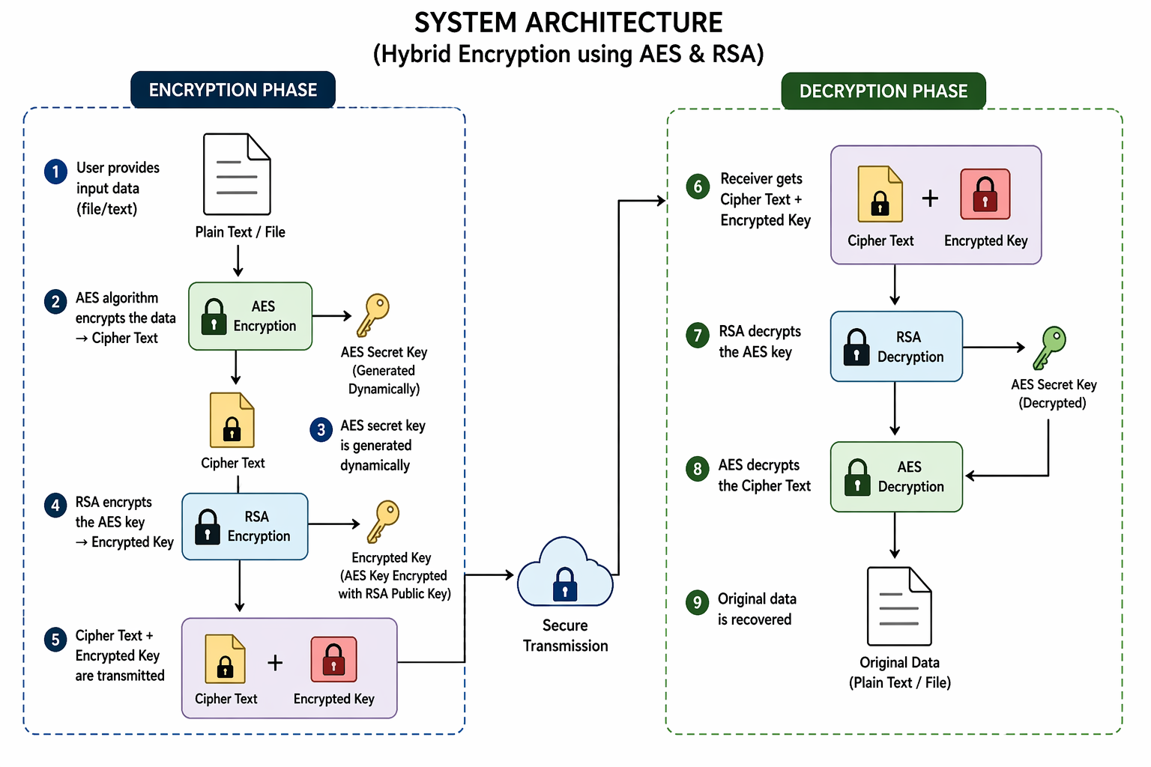
System Architecture :
Figure 1 : System Architecture
Encryption Phase
User provides input data (file/text)
AES algorithm encrypts the data → Cipher Text
AES secret key is generated dynamically
RSA encrypts the AES key → Encrypted Key
Cipher Text + Encrypted Key are transmitted
Decryption Phase
Receiver gets Cipher Text + Encrypted Key
RSA decrypts the AES key
AES decrypts the Cipher Text
Original data is recovered

Slide 9
Tools & Technologies Used :
The implementation and analysis of the proposed cryptographic system are carried out using a carefully selected set of software tools .
🐍
🔐
Python
Crypto Libraries
Primary programming language for implementing AES and hybrid encryption algorithms.
Used to implement secure encryption and decryption operations.
📈
🖥️
Visualization
CPU Environment
Tools for generating clear performance comparisons..
Ensuring consistent, reproducible results in a standard CPU execution environment.
Notes:
‹#›

Slide 10
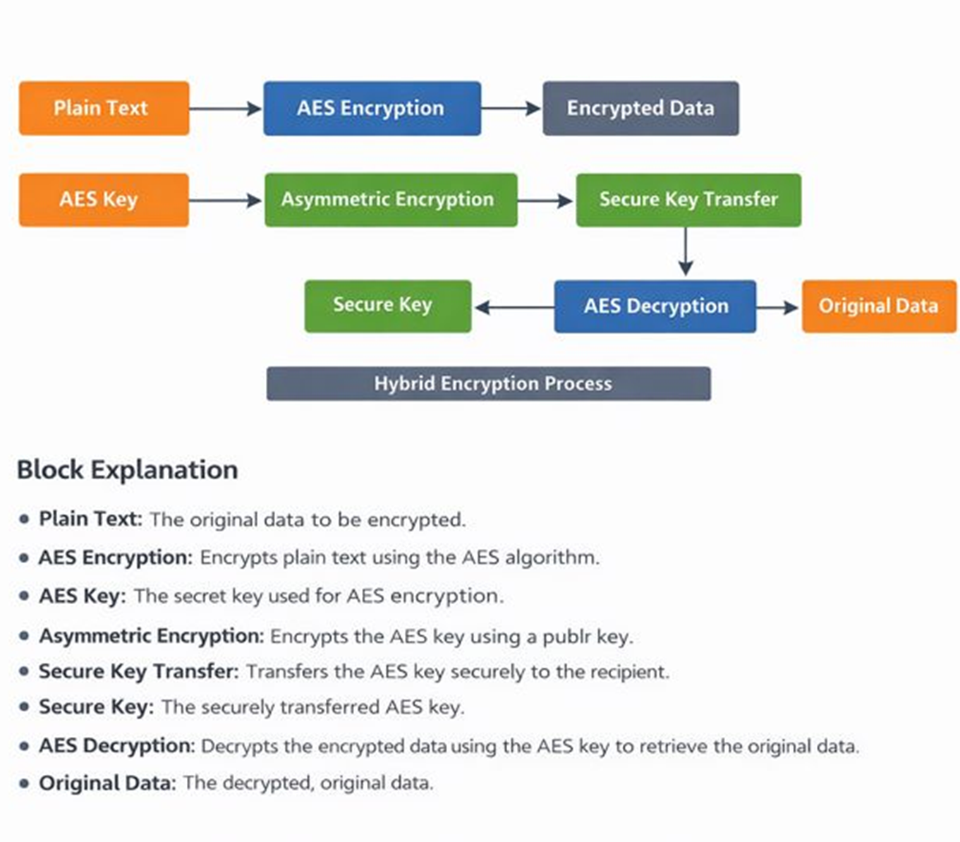
Methodology :
Figure-2: Working Flow of Methodology

Slide 11
Implementation :
The system is developed as a web-based application using Django
User provides input data (text/file) through the interface
AES algorithm is used to encrypt the data into cipher text
A dynamic AES key is generated during encryption
RSA algorithm encrypts the AES key for secure transmission
Encrypted data and key are sent securely to the receiver
At the receiver side, RSA decrypts the key and AES decrypts the data
The system ensures both security and efficient performance

Slide 12
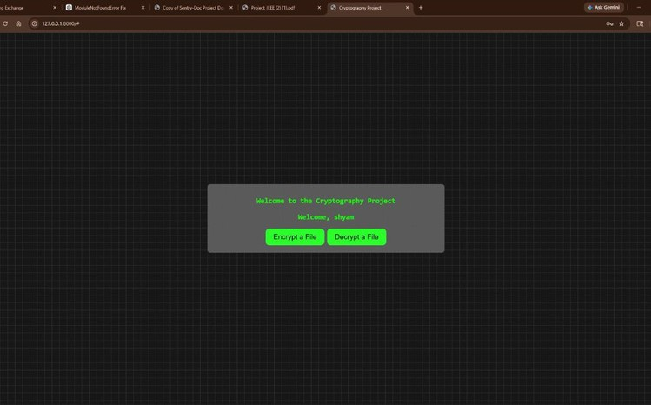
Results & Output :
Screenshot 1 – Project interface

Slide 13

Results & Output :
Screenshot 2 – Encryption interface

Slide 14
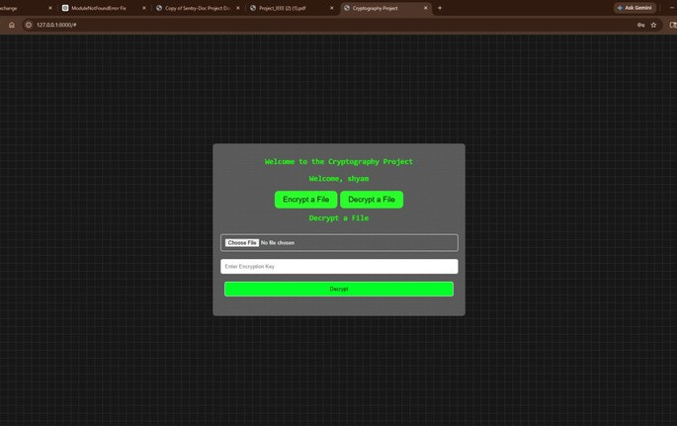
Results & Output :
Screenshot 3 - Decryption Interface

Slide 15
Comparison with Existing Approaches :
Approach | Speed | Security | Problem
AES | Fast | Medium | Key sharing issue
3DES | Slow | High | High overhead
RSA | Very Slow | Very High | Not for bulk data
Hybrid (Proposed) | Fast | Very High | Balanced
Table-2: Comparison Analysis

Slide 16
Advantages & Limitations :
Advantages:
High Security: Combines AES and RSA to provide strong protection against unauthorized access
Fast Performance: AES ensures efficient encryption and decryption of large data
Secure Key Exchange: RSA securely encrypts the AES key, solving key distribution issues
Balanced Approach: Achieves both security and performance compared to traditional methods
Real-Time Applicability: Suitable for applications like cloud storage, secure communication, and online transactions
Limitations:
Computational Overhead: Slight increase in processing due to use of dual algorithms
Complex Implementation: Integration of AES and RSA increases system complexity
Key Management: Requires proper handling and storage of encryption keys
Resource Usage: Asymmetric encryption consumes more computational resources
Scalability Challenges: Performance may reduce for very large-scale systems

Slide 17


Future Scope :
We have carefully considered the panel's valuable feedback, integrating some suggestions into our current work and planning others for future enhancements. They are :
Parallel / GPU Acceleration
Dynamic Key Generation & Rotation
Currently the project focuses on algorithmic performance analysis of AES and hybrid encryption on standard CPU-based systems . Parallel and GPU-accelerated encryption has been identified as a future enhancement
This Project Already supports dynamic key generation during runtime But the Automated key rotation mechanisms can be incorporated as an extension in future phases
Project Continuation/ What Next
The current work establishes a strong foundation by implementing AES and hybrid encryption models. Future work includes system with parallel processing, GPU acceleration, and advanced key lifecycle management.
Notes:
‹#›

Slide 18
Conclusion:
Summary : This project presents a comparative analysis of AES encryption and a hybrid cryptographic approach to improve data security. By combining the speed of AES with the secure key exchange capability of asymmetric encryption, the proposed system achieves a balance between performance and security. Experimental results and benchmarking demonstrate that hybrid encryption provides enhanced protection with acceptable performance overhead.
In conclusion, our project shows that hybrid encryption is more secure than AES alone while maintaining good performance. It is useful for real-world applications like cloud security and secure data transmission and provides scope for future enhancements.
Notes:
‹#›

Slide 19
References
[1] Daemen, J., & Rijmen, V., "The Design of Rijndael: AES — The Advanced Encryption Standard", SpringerVerlag, 2002.
[2] Tuchman, W., Hellman Presents No Shortcut Solutions to DES, IEEE Spectrum, 1979 of DES Motivation for stronger encryption standards (3DES context) Used for Historical background
[3] Stallings, W., "Cryptography and Network Security: Principles and Practice", Pearson Education, 2016.
[4] Khan, M., RSA and AES Based Hybrid Encryption Technique for Enhancing Data Security in Cloud Computing, International Journal of Research and Analytical Reviews, 2023.
[5] Bharti, J., & Singh, S., A Hybrid Approach Using AES-RSA Encryption for Cloud Data Security, International Journal of Intelligent Systems and Applications in Engineering, 2024.
[6] Ahialey, A., Hybrid Encryption Models for Optimal Balance of Security, Scalability, and Computational Efficiency in Cloud Computing, Cureus Journal, 2025.
[7] Elkabbany, G. F., Aslan, H. K., & Rasslan, M. N., A Design of a Fast Parallel-Pipelined Implementation of AES, arXiv:1501.01427, 2015.
Notes:
‹#›

Slide 20
Dissemination of The Work :
Research article Title : Design and Educational Implementation of a Web-Based Hybrid Encryption
System Using Django
Name of The Journal : IJCRT
Web Resource Link to Access :
IJCRT Publication Details : https://ijcrt.org/papers/IJCRT2603749.pdf

Slide 21
Thank You…

